Slide 1
Data 604 Project
By Tony Mei

Slide 2
Problem and its Significance
We will be simulation an initial investment of $1000 in the stock market vs. a savings account
Factors : interest rate, contributions per year
The significance of this simulation is to advise our client which investment methods will fit their financial goals

Slide 3
Simulation
Interest rate for stock market is 8% annually
Savings account rate is 0.01%
Contributions annual to the balance will be the same with 10$

Slide 4
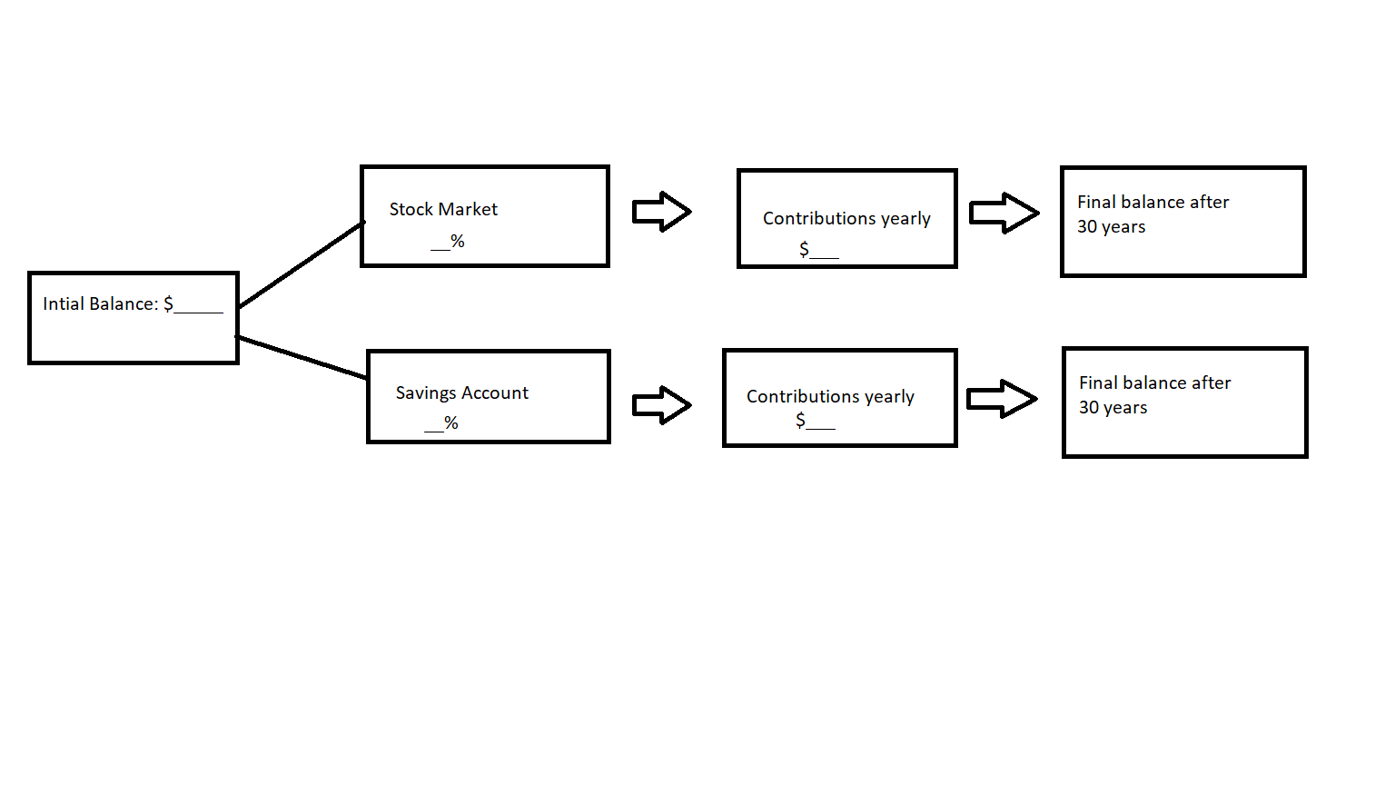
Flowchart

Slide 5
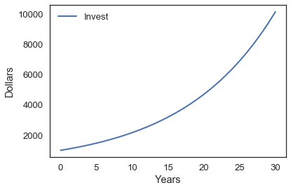
Stock market Graph

Slide 6
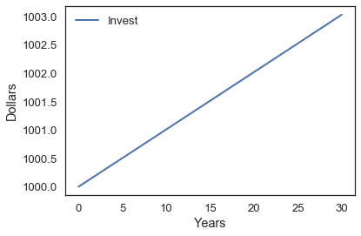
Savings account Graph

Slide 7
Conclusion
Investment is the stock market yield us with a higher return compared to the savings account. We see a exponential curve in the Stock market graph vs. a linear line in the saving account graph.
However, this simulation does not factor in the risk factors of the stock market, up and down trends, the additional fees of buying and trading.
Saving account rate has no fee and there is no risk factor aside from your bank doing bankrupt. However you will still be FDIC insured up to $250k, which covers our initial balance in this case.

